Slide 1




Slide 2





Atliq Hardware
Consumer goods
Ad-hoc Insights
presented by Gouhar Ali

Slide 3






About
Company
Atliq Hardwares is one of the leading computer hardware producers in India and well expanded in other countries too.
PC
Accessories
Storage & networking

Slide 4


AGENDA
Overview of the project
Data sets
Ad-hoc-request
Insights

Slide 5

Overview of the project
the management of Atliq Hardware noticed that they do not get enough insights to make quick and smart data-informed decisions.
Tony Sharma, data analytics director wanted to hire someone who is good at both tech and soft skills.
He decided to conduct a SQL challenge which will help him understand both the skills.

Slide 6



Meet Our
tony Sharma
Best
Team
Data Analytics Director at
Atliq Hardware
Gouhar Ali
Junior Data Analyst

Slide 7

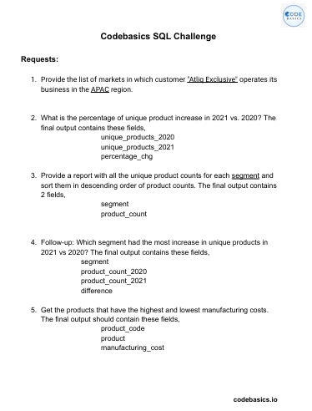
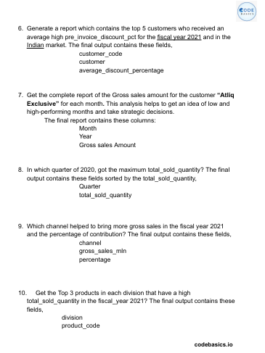
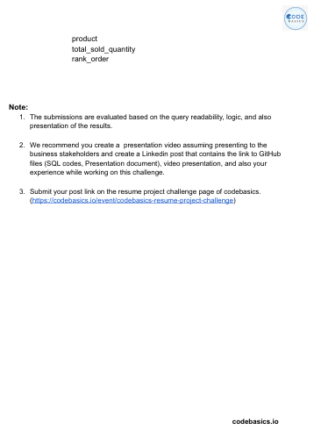
DATA SETS
dim_customer
dim_product
fact_gross_price
fact_manufacturing_cost
fact_pre_invoice_diduction
fact_sales_monthly

Slide 8
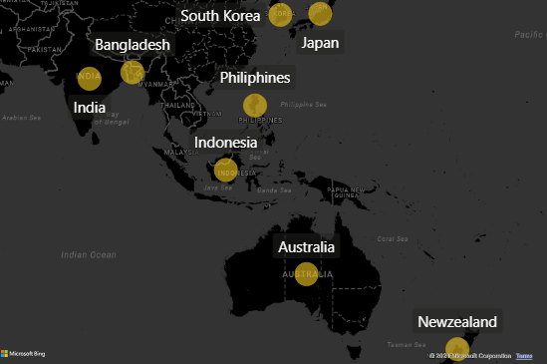

Ad_hoc_request
# 1. Provide the list of markets in which customer " Atliq Exclusive" operates its business in the "APAC" region?
Input
SELECT DISTINCT market
FROM dim_customer
Where customer = "Atliq Exclusive" and region = "APAC“
ORDER BY market;
Atliq Exclusive
Market in ‘APAC’
region
Output

Slide 9

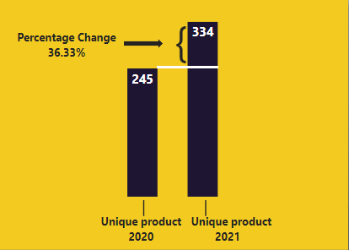
# 2. What is the percentage of unique product increase in 2021 vs. 2020? The final output contains these fields, unique_products_2020, unique_products_2021, percentage_chg
In Put
Out Put
SELECT A.*, B.*,
CONCAT(ROUND((unique_product_2021/unique_product_2020 - 1)*100,2), '%') AS percentage_cng
FROM
(
(SELECT COUNT(DISTINCT product_code) as unique_product_2020 FROM fact_sales_monthly
WHERE fiscal_year = 2020) as A
,
(SELECT COUNT(DISTINCT product_code) as unique_product_2021 FROM fact_sales_monthly
WHERE fiscal_year = 2021) as B
)

Slide 10
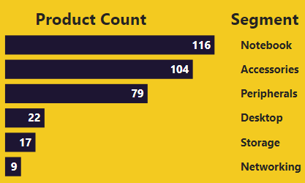
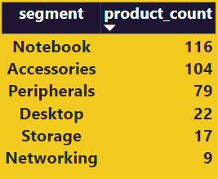
# 3. Provide a report with all the unique product counts for each segment and sort them in descending order of product counts ? The final output contains 2 fields segment , product_count
In Put
SELECT dp.segment, count(distinct(fs.product_code)) as product_count
FROM dim_product dp
INNER JOIN fact_sales_monthly fs ON dp.product_code = fs.product_code
GROUP BY segment
ORDER BY product_count DESC ;
Out Put

Slide 11
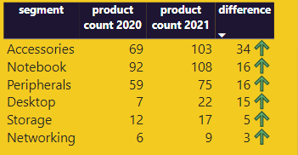
Follow-up: Which segment had the most increase in unique products in 2021 vs 2020? The final output contains these fields, segment product_count_2020, product_count_2021, difference
In Put
Out Put
With cte1 AS (
(SELECT dp.segment, COUNT(DISTINCT(fs.product_code)) AS product_count_2020
FROM dim_product dp INNER JOIN fact_sales_monthly fs
USING(product_code)
WHERE fs.fiscal_year = 2020
GROUP BY dp.segment))
,
cte2 AS (
(SELECT dp.segment, COUNT(DISTINCT(fs.product_code)) AS product_count_2021
FROM dim_product dp INNER JOIN fact_sales_monthly fs
USING(product_code)
WHERE fs.fiscal_year= 2021
GROUP BY dp.segment)
)
SELECT *, (product_count_2021 - product_count_2020) AS difference
FROM CTE1 INNER JOIN CTE2
USING(segment)
ORDER BY difference DESC ;

Slide 12
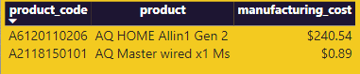
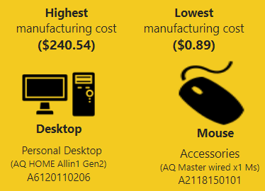
# 5. Get the products that have the highest and lowest manufacturing costs. The final output should contain these fields, product code , product , manufacturing cost
In Put
Out Put
SELECT p.product_code,p.product,ROUND(m.manufacturing_cost,2) AS manufacturing_cost
FROM dim_product p INNER JOIN fact_manufacturing_cost m
USING(product_code)
WHERE m.manufacturing_cost = (SELECT MAX(manufacturing_cost)
FROM fact_manufacturing_cost)
UNION ALL
SELECT p.product_code, p.product,ROUND(m.manufacturing_cost,2) AS manufacturing_cost
FROM dim_product p INNER JOIN fact_manufacturing_cost m
USING(product_code)
WHERE m.manufacturing_cost = (SELECT MIN(manufacturing_cost)
FROM fact_manufacturing_cost)

Slide 13
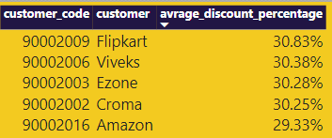
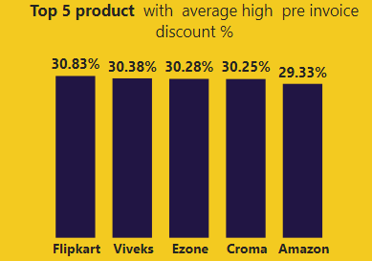
# 6. Generate a report which contains the top 5 customers who received an average high pre invoice discount percentage for the fiscal year 2021 and in the Indian market. The final output contains these fields,
customer code ,customer, average discount percentage
InPut
OutPut
SELECT c.customer_code, c.customer,
CONCAT(ROUND(AVG(p.pre_invoice_discount_pct)*100, 2), "%") AS avrage_discount_percentage
FROM dim_customer c
INNER JOIN fact_pre_invoice_deductions p
USING(customer_code)
WHERE P.fiscal_year = 2021 AND c.market = "India"
GROUP BY c.customer_code, c.customer
ORDER BY ROUND(AVG(p.pre_invoice_discount_pct)*100, 2) DESC LIMIT 5;

Slide 14
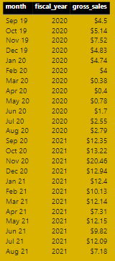
# 7. Get the complete report of the Gross sales amount for the customer “Atliq Exclusive” for each month. This analysis helps to get an idea of low and high-performing months and take strategic decisions.
The final report contains these columns: Month, Year, Gross sales Amount
In Put
Out Put
WITH cte1 AS (
(SELECT s.*, g.gross_price FROM fact_sales_monthly s INNER JOIN fact_gross_price g
ON s.product_code = g.product_code AND s.fiscal_year = g.fiscal_year)
)
SELECT CONCAT(MONTHNAME(ct.date),' ' , YEAR(ct.date)) AS month, ct.fiscal_year,
CONCAT("$ ",ROUND(SUM(ct.sold_quantity*ct.gross_price)/1000000,2)) gross_sales_amount_mln
FROM cte1 ct INNER JOIN dim_customer c
USING(customer_code)
WHERE c.customer = "Atliq Exclusive"
GROUP BY month, s.fiscal_year ;

Slide 15
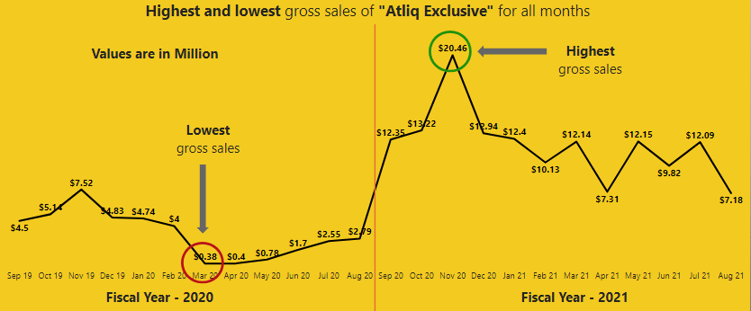
Monthly trend chart of each month for fiscal year 2020 - 2021

Slide 16
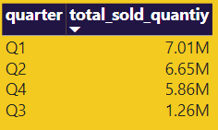
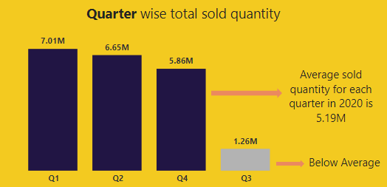
# 8. In which quarter of 2020, got the maximum total sold quantity ? The final output contains these fields sorted by the total sold quantity . Quarter, total sold quantity
In Put
Out Put
WITH cte1 AS (
SELECT month(date) AS month,sold_quantity
FROM fact_sales_monthly
WHERE fiscal_year = "2020"
)
SELECT (CASE
WHEN month in (9,10,11) THEN "Q1"
WHEN month in (12,1,2) THEN "Q2"
WHEN month in (3,14,5) THEN "Q3"
ELSE("Q4")
END) AS quarter, SUM(sold_quantity) AS total_sold_quantiy
FROM cte1
GROUP BY quarter
ORDER BY total_sold_quantiy DESC;

Slide 17
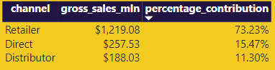
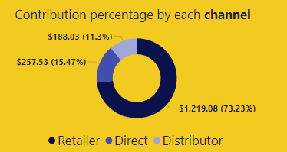
# 9. Which channel helped to bring more gross sales in the fiscal year 2021 and the percentage of contribution? The final output contains these fields, channel, gross sales Million, percentage
In Put
Out Put
WITH cte1 AS(
SELECT c.channel, ROUND(SUM(g.gross_price * s.sold_quantity)/1000000,2) as gross_sales_mln
FROM fact_sales_monthly s INNER JOIN fact_gross_price g
ON s.product_code = g.product_code AND s.fiscal_year = g.fiscal_year
JOIN dim_customer c ON s.customer_code = c.customer_code
WHERE s.fiscal_year = 2021
GROUP BY channel
)
SELECT
channel,
gross_sales_mln,
CONCAT(ROUND((gross_sales_mln/SUM(gross_sales_mln) OVER ())*100,2),'%') AS percentage_contribution
FROM
cte1;

Slide 18
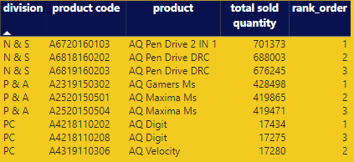
# 10. Get the Top 3 products in each division that have a high total sold quantity in the fiscal year 2021? The final output contains these fields, division, product code
In Put
Out Put
WITH cte1 AS(
SELECT p.division,p.product_code, p.product,
SUM(sold_quantity) AS total_sold_quantity
FROM dim_product p INNER JOIN fact_sales_monthly s
ON p.product_code = s.product_code
WHERE fiscal_year = 2021
GROUP BY p.division,p.product_code, p.product
) ,
cte2 AS (
SELECT *,
RANK() OVER ( PARTITION BY division ORDER BY total_sold_quantity DESC ) AS rank_order
FROM cte1)
SELECT * FROM cte2
WHERE rank_order <=3;

Slide 19
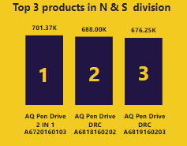
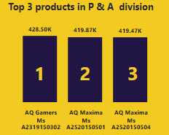
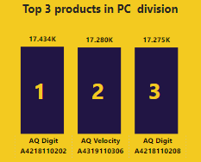
Top 3 product in each division with high total sold quantity in fiscal year 2021

Slide 20
THANKS
FOR WATCHING
gouharali55520@gmail.com

